Slide 1
Mood Disorders, Suicide, Suicide-by-Cop
Andrea Watts, MS, LMHC and Cara Wilson, Ph.D.
BCSO/APD Behavioral Sciences Division
505-362-4131
a.watts@fbha-nm.com

Slide 2
Why Should LEOs Learn About This?
Mood disorders are very common
Accounts for most suicidal, passive neglect bx
Suicidal persons are sometimes homicidal persons
LEOs expected to help
Public, suspects, victims, friends, family, etc.

Slide 3
Mood Disorders
A word on “disorder”
Certain set of symptoms, certain severity, certain duration, interferes with functioning, change from before, not due to something else
Depressive Disorders
Major depressive (MDD)
Dysthymia
Bipolar Disorders
“Manic depressive”
BPAD I, BPAD II

Slide 4
What is Depression?
Clinical depression is a serious medical condition that negatively affects how a person thinks, feels, and behaves. Symptoms may include:
Difficulty concentrating, remembering details, and making decisions
Fatigue and decreased energy
Feelings of guilt, worthlessness, and/or helplessness
Feelings of hopelessness and/or pessimism
Insomnia, early-morning wakefulness, or excessive sleeping
Irritability, restlessness
Loss of interest in activities or hobbies
Overeating or appetite loss
Persistent aches or pains, headaches, cramps, or digestive problems
Persistent sad or "empty" feelings
Thoughts of death or suicide, suicide attempt or plan

Slide 5
MDD & Thinking
Filtering
“Black and White” or polarized thinking
Overgeneralization
Jumping to conclusions
Catastrophizing or minimization
Personalization
Emotional reasoning

Slide 6
Key Facts on Depression
Medical condition, not weakness
Quite common: ~ 5% of population at any given time
< 20% of population (lifetime), 5-10% M, 10-20% F
But, 80% or more will not develop depression
One of most treatable mental illnesses (Miller 2006)
Up to 90% response rate to medication, therapy
Many folks, including LEOs, treated successfully w/o missing work
If untreated, likely last > 6 months
Role in up to 75% of psychiatric hospitalizations

Slide 7
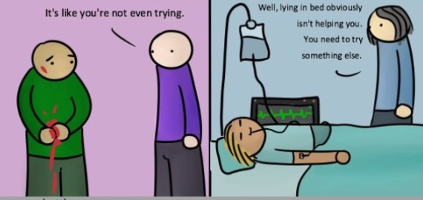

Slide 8
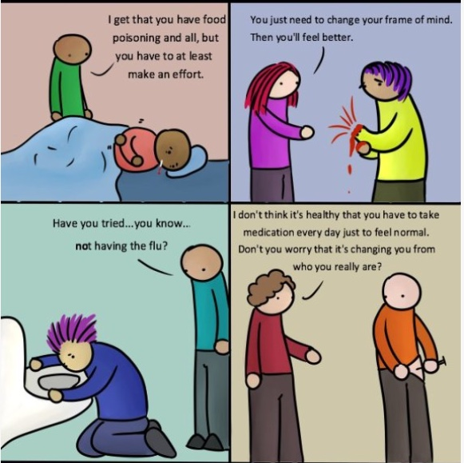

Slide 9
LEO Encounters
Witnesses, subject, public, fellow officers
Welfare check
Interrupted homicide/suicide
Suicide in progress (or completed suicide)
Barricaded, with or without hostage(s)
“Man with a gun” call
Bizarre behavior (bridge jumper, running in traffic, setting self on fire)
Terrorism, suicide bombers, etc

Slide 10
LEO Encounters (2)
Depression common link in barricades where suicide or homicide/suicide is threatened (Heiskell 2001)
92% of all law enforcement barricade incidents are emotionally driven (FBI stats)
~ 70% of SWAT call outs for barricaded individuals who have not (yet) broken the law (Johnson 2007)
You already have had contact with individuals suffering from Mood D/Os

Slide 11
Remember…
Not just feeling a bit “down” or “off”
Change in functioning, not better accounted for by anything else
Person may not use the word “depressed”
Disappointed, angry, irritable, “emptiness”
May be apparent to episodic observer
“Just saw Uncle Fred and he looks like crap…”
Rarely flies solo
Anxiety, substance abuse, PTSD, etc.

Slide 13
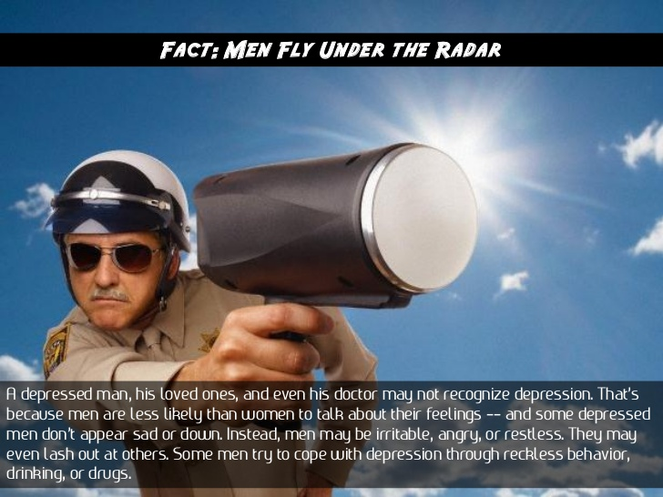

Slide 14
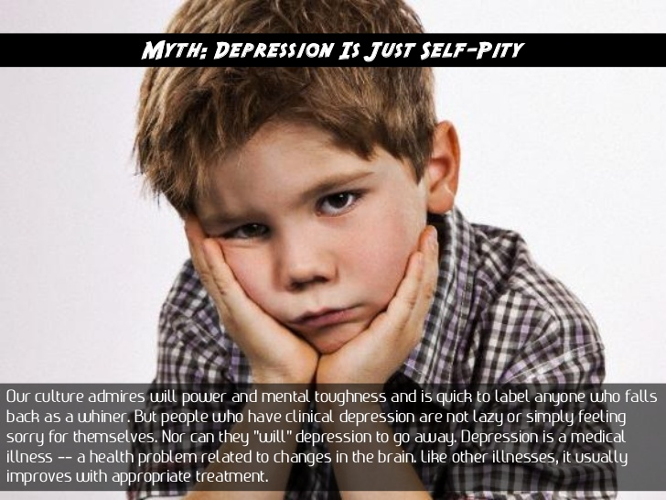

Slide 19
Bipolar D/O
Bipolar I (mania), Bipolar II (hypomania)
Rates (Kessler et al., 2005)
12-month prevalence: 2.6% of adults
Lifetime: 3.9% of adults
Avg age of onset: 25 years
Mania
Distinct time period (> week)
Elevated, expansive, irritable mood
Decreased need for sleep
Grandiosity, inflated self esteem
Talkative, pressured speech, distractibility, racing thoughts
Psychomotor agitation, increased pleasure-seeking or goal-directed behavior

Slide 20
Famous People w/Mood Disorders
Drew Carey
Alisha Keys
Kurt Cobain
Terry Bradshaw
Vincent Van Gogh
Halle Berry
Chris Farley
Abraham Lincoln
Princess Diana
Ken Griffey Jr
Eddie Griffin
Ashley Judd
Ernest Hemmingway
Oprah Winfrey

Slide 21
Treatment
Psychotherapy
Cognitive-behavioral interventions
Group, individual
Medications
Older
E.g., Elavil (amitriptyline)
Major drawback: Can be lethal in even moderate overdose
Newer
E.g., Prozac (fluoxetine), Zoloft (sertraline)
Fewer side effects, less overdose potential
Note: Many folks, including law enforcement officers, can be treated with newer antidepressant medications and remain on duty!

Slide 22
Suicide & Suicide by Cop

Slide 23
Suicide
The Suicide rate for the U.S. is approximately 14.5 per 100,000
the Albuquerque Metro area would be expected to have about 75 to 90 suicides per year.
New Mexico is ranked 5th for the US.
Suicidal behavior usually begins with thoughts, fantasies about ending one’s own life.
Alcohol sometimes short-circuits the thinking process.
Why?

Slide 24
Suicidal Triad
Alcohol - either chronically or acutely
Depression/Isolation – divorced, a person who has “burned his bridges “ w/family & friends
Hopelessness - both real and perceived

Slide 25
Suicidal Gesture vs. Attempt
Suicide plans range from vague thoughts to elaborate and detailed instructions, letters, etc.
Suicide gesture
Behavior that mimics suicide but the intent is to change someone else’s behavior.
Suicide attempt
Behavior that has as its intent the ending of a life.

Slide 27
Suicide: MMPI (Ask about these)
Motive
Relief (end pain), avoid negative consequences, unburden loved ones, assert control
Often tremendous ambivalence
Means
How lethal? How accessible?
Plan
Wide range: vague thoughts to detailed plan
Intent
Does person intend to harm themselves, others?

Slide 28
Common Initiating Events
Losses of significant relationships (the end of an intimate relationship, death of a parent, or loss of a child).
Changes in financial status (the loss of a job or threatened financial disaster).
Changes in living arrangements (being released from an institution, for example).
Feeling humiliated or being rejected, especially in public.
What were the initiating events?
Michael Marron (Arsonist)
Elliott Rodger (Santa Barbara Shooter)

Slide 29
Warning Signs of Suicide
Depression (esp. untreated)
Hopelessness, helplessness
Cognitive distortions
Talking or writing about death or suicide
Withdrawing from family, friends
Feeling strong anger or rage
Abusing drugs or alcohol
Impulsivity
Giving away prized possessions
Writing a will
Sudden peace, serenity, etc

Slide 30
How LEOs Can Help
Active listening
Go beyond the words
Empathic communication
Empathy Vs. Sympathy
Imagine that person’s perspective, not yours
Use the direct words like suicide and kill yourself
Generally avoid: “I need you to…”
Explore options, but you will not solve all problems
Provide support and understanding
Generally avoid saying “I understand how you feel…”

Slide 31
Useful Phrases
It seems you’re really sad/angry/upset, etc.
Labeling emotion
Are you thinking of harming, killing yourself (today, right now, tonight, etc.)?
I don’t know too much about [problem you can’t possibly solve], but I do know I care what happens to you today and want to help...
Tell me more about that…
Yes, you’re right, I don’t want you hurting yourself…
I’m sorry you’ve been dismissed and ignored before, but I’m interested/care now…

Slide 32
Suicide: the “Don’ts”
Ridicule those who seek help
Offer simple solutions, “get over it”
Judge and condemn
Help someone hide or ignore destructive behavior
Drug, alcohol abuse; violence; recklessness
Ignore any problems you see

Slide 33
Suicide By Cop
AKA “victim-precipitated homicide”
Subject provokes LEO, suicidal intent
Question—If a barricaded armed suspect steps out to face police with a firearm in his hand, is he suicidal or homicidal?
Answer--???
A man willing to take his own life is capable of killing others.
10-15% of police shootings are suicide by cop

Slide 34
Profile
Call often starts as a disturbance call, i.e. “man waving a gun around” or “man threatening neighbors with a knife.”
Subject is usually:
Male
Young
Intoxicated
Despondent
Angry
Often with a history of prior contact with police.
49% show no evidence of planning

Slide 35
Motives & Triggers
Motives
Avoid negative consequences
Express rage, revenge
Total need for control then loss of control
Calling attention to a personal issue
“Moral loophole”
Most immediate trigger: pointing gun at an officer
Resistant to initial verbal de-escalation
“You’re just going to have to kill me…”
Can happen quickly (avg is 17 minutes)

Slide 36
Possible Outcomes
Subject may respond to skillful, persistent verbal de-escalation
Simply repeating commands is not verbal de-escalation
Reinforce any move toward de-escalation
Outcome based on
Subject’s behavior, motives, wherewithal
Level of intoxication
Responders’ skill
Available resources

Slide 37
Suicide By Cop: The “Do’s”
Do remember officer safety
Do ask directly, but supportively, if subject is planning to harm/kill himself/herself
Motive, Means, Plan, Intent (MMPI)
Do keep hope, no matter how hopeless a person’s situation may seem.
Do remember this stuff may apply to fellow officers and to YOU

Slide 38
Suicide By Cop: The “Don’ts”
Don’t let a suicide by cop event lead to injury/death of officer
Don’t go face-to-face if subject has a gun
Don’t use family member to talk with subject
Don’t move closer to the subject (will just add pressure)

Slide 39
Questions?

