Slide 1
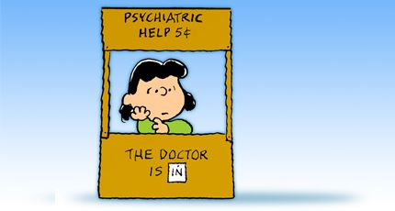
Mobile Crisis Team
Mike Sciarrillo, P1/C, LAYN
Lisa Galles, LPCC, HopeWorks

Slide 2
Course Objectives
What the Mobile Crisis Team consists of
Why the Mobile Crisis Team was created
What calls the Mobile Crisis Team will respond to

Slide 3
What is the Mobile Crisis Team?
As defined in SOP 2-19:
The Mobile Crisis Team (MCT) are co-responder teams composed of one eCIT Officer, from APD or BCSO, and one independently licensed Clinician through St. Martins Hopeworks.

Slide 4
What is the Mobile Crisis Team
The Independently licensed Clinician is Master’s Level or Doctorate Level
Can write Certificates of Evaluation on scene
Can provide resources
Otherwise unavailable to police
Another opinion on scene to determine what is best for each individual
Their goal is to keep citizens in the community

Slide 5
What is the Mobile Crisis Team
Take calls citywide in all six area commands
Their goal is to keep citizens in the community when legal to do so.
No charges
No warrants
Does not meet standard for 43-1-10
Does not meet standard for a Certificate of Evaluation

Slide 6
What is the Mobile Crisis Team
eCIT Trained Officer/Deputy
Two from Albuquerque Police Department
Two from Bernalillo County Sheriff’s Office

Slide 7
Benefits of the Mobile Crisis Team
Reduction in police needed for Behavioral Health Calls
Reduction in custody or detention
De-criminalizing individuals living with Behavioral Health Illness
Better access Behavioral Health Support and Services
Quicker access to Behavioral Health Support at the time of a crisis

Slide 8
Why does MCT exist??

Slide 9
Why does MCT exist?
In 2015, Bernalillo County imposed a new tax, which collected $17 Million in one year
In 2015, Albuquerque spent $16 Million on Behavioral Health
Between Bernalillo County and the City of Albuquerque, new idea of Mobile Crisis Teams came about

Slide 10
Why does MCT exist?
Original idea was TWO Officers to One Master Level Clinician
Two Teams from Albuquerque Police Department
One Team from Bernalillo County Sheriff’s Office

Slide 11
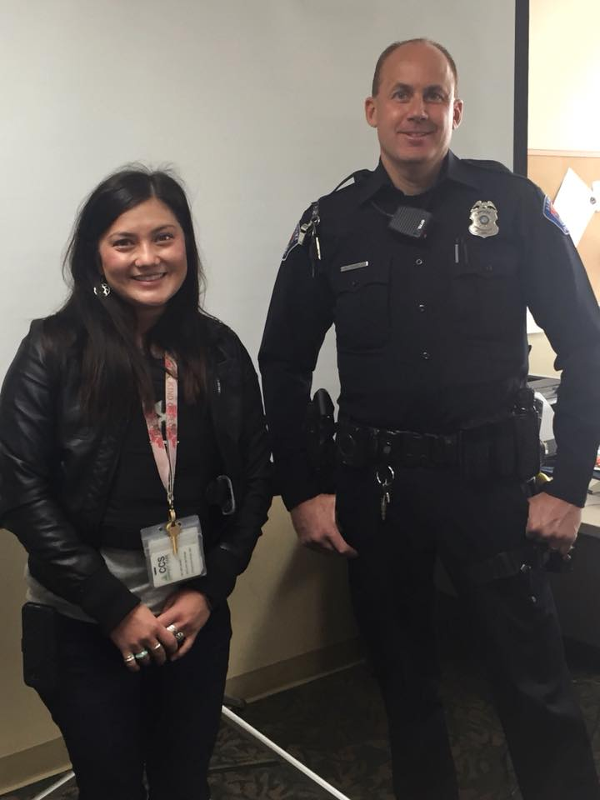
Why does MCT exist?
MCT did not go in effect until 03/03/2018
First Mobile Crisis Team came from Albuquerque Police Department
Lisa Galles, LPCC
Michael Sciarrillo, P1/C
Average about 110 calls

Slide 12
Calls that MCT will respond to
Most Suicide Calls
Persons that are highly delusional or paranoid
Disturbances, Suspicious Persons or Wel-Fare Check Calls where there is a Mental Health Component
Calls where a Clinician can and will be used

Slide 13
Calls that MCT will respond to
Select High Priority Behavioral Health calls where a Certificate of Evaluation is already written but an MCT Unit is requested
Will be determined by each MCT Unit
Domestic Disputes with a Behavioral Health Element

Slide 14
Tips for responding with MCT
MCT Officers typically only need one Assisting Officer to respond with them
The scene needs to be safe for the Clinician
Assisting Officer will help with scene security and Clinician Safety
Clinician is a civilian, does not have authority to use force and be a part of force array

Slide 15
Tips for responding with MCT
MCT will not be used for perimeters
MCT will not respond if the Clinician serves no purpose by being on scene
MCT Officers typically take over the scene and become primary
Only a select calls will be turned back to the field
Once engaged, the Clinician will rarely need the officer to add to the conversation

Slide 16
Questions???
apdcit@cabq.gov

