Slide 1
Resiliency
Nils Rosenbaum ECHO September 18th 2018

Slide 2
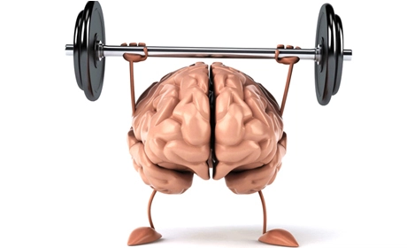
Mental Toughness
The ability to perform at ones best, to train hard, to set and achieve goals, to overcome adversity.
A term from athletics.

Slide 3
Grit
The ability to stay the course and fight through adversity. The ability to achieve goals despite difficulty.
You need grit to be mentally tough.
A term mostly from childhood education.

Slide 4
Resiliency
The ability to bounce back, to overcome setbacks, and return to high functioning.
You need resiliency to have grit.

Slide 5
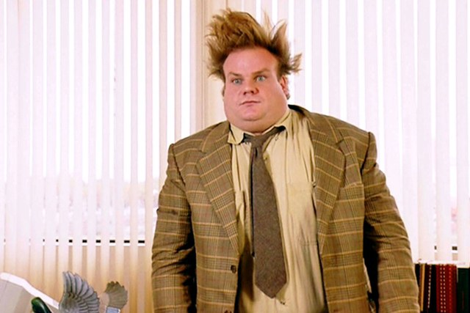
Response to Stress

Slide 6
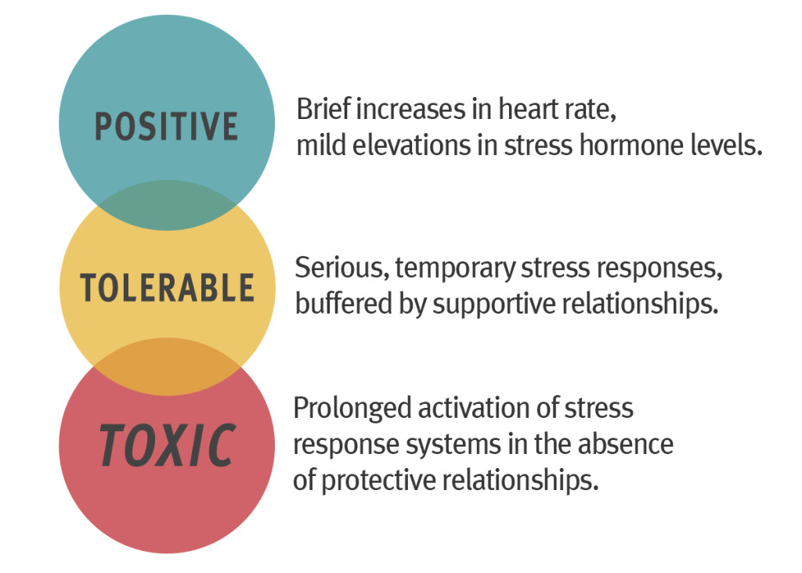
Notes:
Another way of viewing stress reactions that can be healthy or toxic

Slide 7
Responses to Stress

Slide 8
Recommendations From Author
Wider range definition of self
Time management, goal setting, and proactive behaviors
Rational Spending
Exercise
Avoid negative thinking and victim mentality
Notes:
Don’t let the job be your only sense of identity, it can quickly consume officers, who go from enthusiastic to vulnerable, now that work has taken over, they don’t have other outlets when work goes badly, and it always does for everyone at some point.
Manage your time off work, make specific plans and stick to them. Put them in your calendar, work toward time with family, friends, vacations, hobbies. Schedule these, don’t just wait for them to happen.
Cops, as much or more than all people, spend too much on big ticket items they don’t need. If you spend more, especially on credit, on a car or motorcycle or even a boat, you’ll make those payments for a long time. Then you’ll have less money, work overtime, and the imbalance between personal and work life expands.
Exercise is a great way to clear your mind and be healthy, most officers know this. It’s about making the time.
Avoid negative thinking. This is much easier said than done, and is the basis of CBT.

Slide 9
Take control of what you can control
Notes:
Ask audience, “What level of control do you have over your work life?”
Some may answer that they have a lot … but what they are referring to is the actual interaction with citizens, which in fact is also highly regulated by laws and the community.
Lead them to answer of “very little”
What they can’t control …
Laws
Politics
The Admin
Where they work
Who will screw them over
Ask. What can they can control in the job?”
What they CAN control on the job …
Integrity
Ethics, including work ethic
Meaning
Ask, “Where do you have more control, at work or at home?”
Ask, “Where can you make the biggest impact on the wellbeing of your life through a greater span of control … work or personal?”

Slide 10
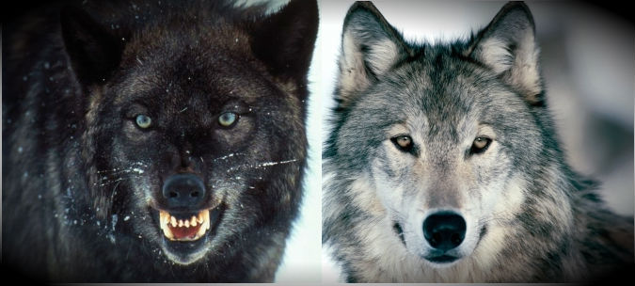
The two wolves
Notes:
Paraphrase the following story ….
An old Cherokee is teaching his grandson about life. “A fight is
going on inside me,” he said to the boy. “It is a terrible fight and it is between two wolves.
One is evil – he is anger, envy, sorrow, regret, greed, arrogance, self-pity, guilt,
resentment, inferiority, lies, false pride, superiority, and ego.”
He continued, “The other is good – his is joy, peace, love, hope, serenity, humility, kindness, benevolence, empathy, generosity, truth, compassion, and faith. The same fight is going on inside you – and inside every other person, too.”
The grandson thought about it for a minute and then asked his grandfather, “Which wolf will win?”
The old Cherokee simply replied, “The one you feed.”
________
This is CBT, taking control of your thoughts and nurturing the positive thinking that you have. Getting angry at the administration, at co-workers, is counterproductive.
Paraphrasing other wise thinkers … Indulging vengeful anger is like taking poison and hoping the other person will die.

Slide 11
Positive Thinking
Combat Negative and Distorted Thinking.
Create positive thinking.

Slide 12
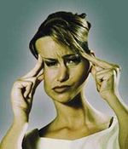
A Few Examples of Distorted Thinking
All or nothing thinking
Catastrophizing
Discounting the Positive

Slide 15
All or nothing thinking

Slide 17
Positive Thinking
Not Pollyanna/Optimistic AND Realistic
Look at setbacks as caused by fixable, temporary, and non-pervasive factors.
Look at positive things in your life as more permanent, caused by your character, and longer lasting.
Work from your strengths, not your weaknesses.
Failures are chances to learn and improve

Slide 18
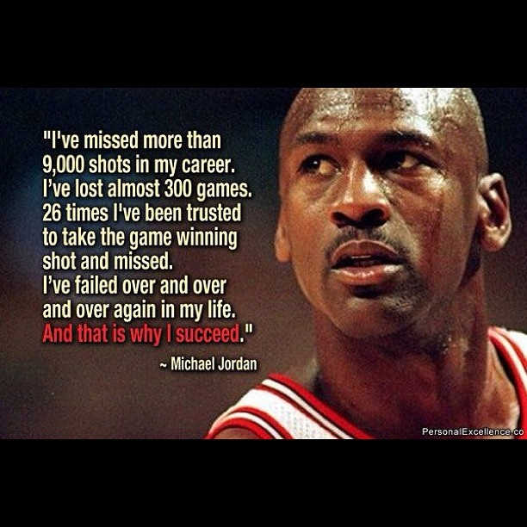
Grit

Slide 19
What are some other recommendations to improve Grit, Resiliency, and Mental Toughness?

Slide 20
Set Goals
Both long term and short term.

Slide 21
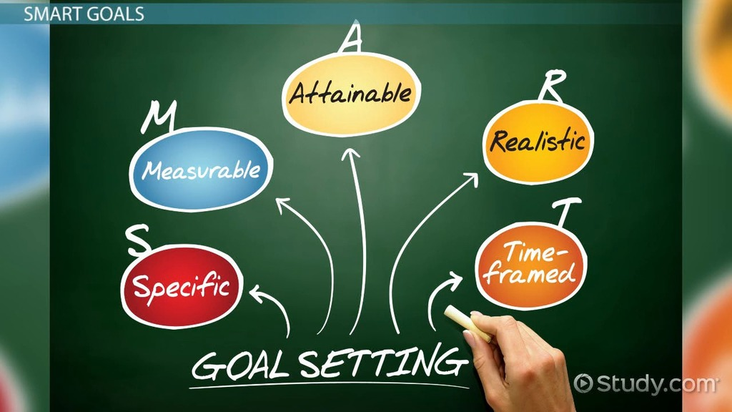
Goals
Create Opportunities for Personnel Challenge

Slide 22
Visualize achieving and working towards you goals.
Visualization as practice.
Jerry West –
“Mr. Clutch,” Rehearsed making those same shots countless times in his mind.

Slide 23
Goals – Perseverance

Slide 24
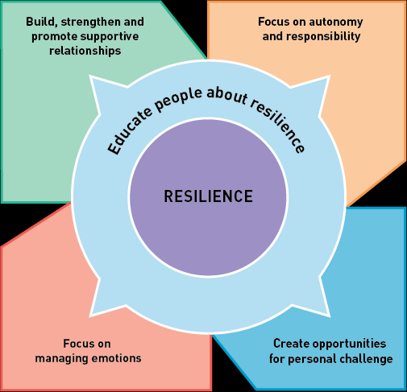
Resiliency Planning

Slide 25
Have a Plan
Manage free time better and
don’t leave your best self at work.
Make schedules to assure you will follow through.
Overcome being stuck by forcing yourself to do things you used to enjoy.
Try to avoid negative people, and find role models.

Slide 26
Other Tips for Resilience
Varied support system, and invest in relationships when times are good for you.
Living with Intentionality – taking control of the life that you can, taking ownership for the decisions you make.
Face Fears and Active Coping – Don’t ignore signs of distress, what you resist persists. Take action, take responsibility.

Slide 27
Manage Emotions and Anxiety
CBT, Positive Thinking
Relaxation Techniques
Battle Breaths
Fuller Awareness
Mindfulness/Meditation

Slide 28
Meaning – a foundation for Resiliency
Victor Frankl (1905 – 1997)
Notes:
He was a holocaust survivor, and devoted his life to studying, understanding, and promoting “meaning.”. ... Without meaning, people fill the void with hedonistic pleasures, power, materialism, hatred, and boredom.

Slide 29
Take control and responsibility
Between stimulus and response there is a space. In that space is our power to choose our response. In our response lies our growth and our freedom.

Slide 31
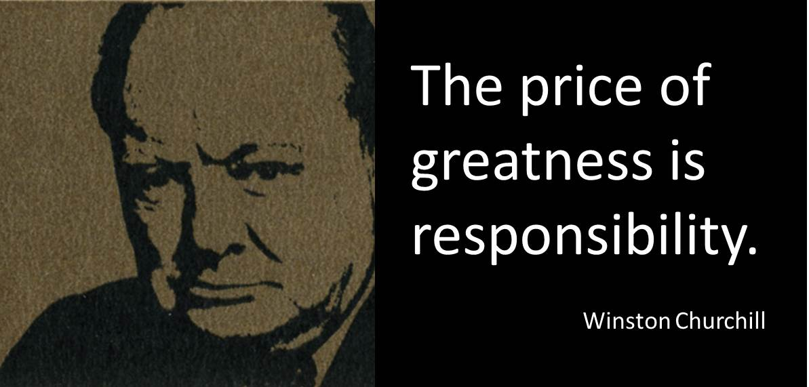
Take control and responsibility
Everything can be taken from a man but one thing: the last of the human freedoms—to choose one’s attitude in any given set of circumstances, to choose one’s own way.

Slide 32
Ask Yourself …
In your own words:
What do you actually do to assure you’ll keep a well rounded life and combat stress of the job?
What have you done this last week to keep old friendships and networks healthy? What time have you invested in them? What were obstacle to doing this if you were unable to?
Notes:
Learning Objective #5
“FTO’s will be able to articulate ways to identify if their trainee is actively using some of the stress management techniques that have been taught.”
Discuss with audience other questions they feel comfortable asking. Remind them to mentally practice these questions as they may feel forced or wooden at first.

Slide 33
Other questions
In your own words:
Do you make efforts to manage your free time with an actual schedule, to make sure you plan and follow through on plans even if you’re tired?
Do you make and keep commitments to friends and family outside of work?
Do you still do hobbies and things you enjoy?
Do you tend to overspend? Do you have a financial plan?
Notes:
Learning Objective #5
“FTO’s will be able to articulate ways to identify if their trainee is actively using some of the stress management techniques that have been taught.”

Slide 34
Other questions
In your own words:
Do feel you have grit? Resiliency? Mental Toughness?
Do you take control and responsibility?
What can you do today to improve these in your life?
Are you as driven by meaning, ethics, and values as you used to be? More? Less?
Notes:
Learning Objective #5
“FTO’s will be able to articulate ways to identify if their trainee is actively using some of the stress management techniques that have been taught.”

Slide 36
How to get a struggling officer help
BSS 764-1600
nrosenbaum@cabq.gov 505-573-5703 (c)
Notes:
Objective #8 “FTO’s will be able to articulate how to initiate professional help for their trainees and how to get the assistance of BSS.”

