Slide 1
Seven Active Listening Skills De-Escalation November 6th^{, 2018}

Slide 2
About Us
Presenters
Nils Rosenbaum, MD
Outreach Psychiatrist
nrosenbaum@cabq.gov
Jeffrey Bludworth
Crisis Intervention Detective
J bludworth@cabq.gov
More information on crisis intervention and de-escalation skills can be found at: http://www.gocit.org/deescalation-crisis-intervention-training.html

Slide 3
Objectives
What is Active Listening
Learn the 7 Skills
Practice the Skills

Slide 4
The Basics

Slide 5
The Basics
Beware of safety concerns
Be aware of your own emotions
Work towards a resolution
Don’t be a jerk
Stay professional
Work towards a resolution
Don’t take things personal
You can always transition into a different approach
Respect, dignity, and empathy

Slide 6
Active Listening

Slide 7
Active Listening Skill
A technique of communication used to let the speaker know you are listening and comprehending the message that is being relayed.
Has been proven effective with de-escalation and rapport building through clinical and research evidence.
Used in numerous applications in business and law enforcement throughout the world.

Slide 8
“When you talk, you are only repeating what you already know. But if you listen, you may learn something new.”
Notes:
This is the Dalai Lama

Slide 9
Why Active Listening?
What are the benefits?
Empathy
Understanding
Retention
Rapport
Influence
Compliance

Slide 10
The Seven Skills
Use these when it is safe to do so, to build rapport

Slide 12
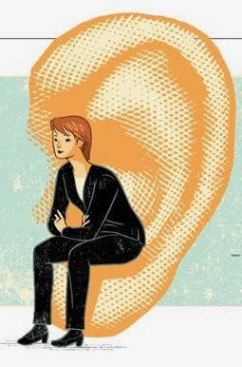
Minimal Encouragers
Open-Ended Questions
Reflecting/Mirroring
Emotion Labeling
Paraphrasing
“I” Messages
Effective Pauses

Slide 13
Emotion Labeling Is our Best Friend in Rapport Building Lets Practice!
Type in the chat the emotion that you see on the following faces.

Slide 14
What emotion do you see?

Slide 15
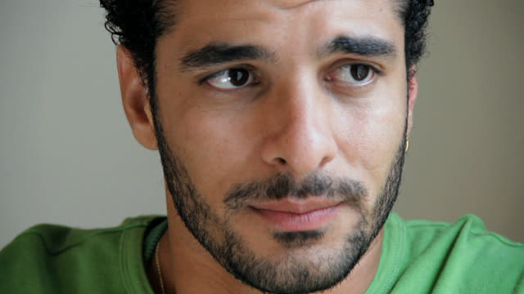
What emotion do you see?

Slide 16
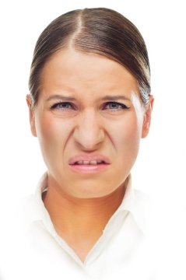
What emotion do you see?

Slide 17
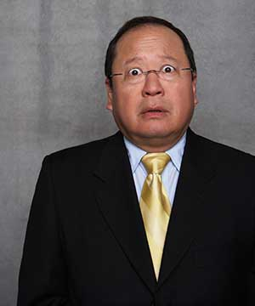
What emotion do you see?

Slide 18
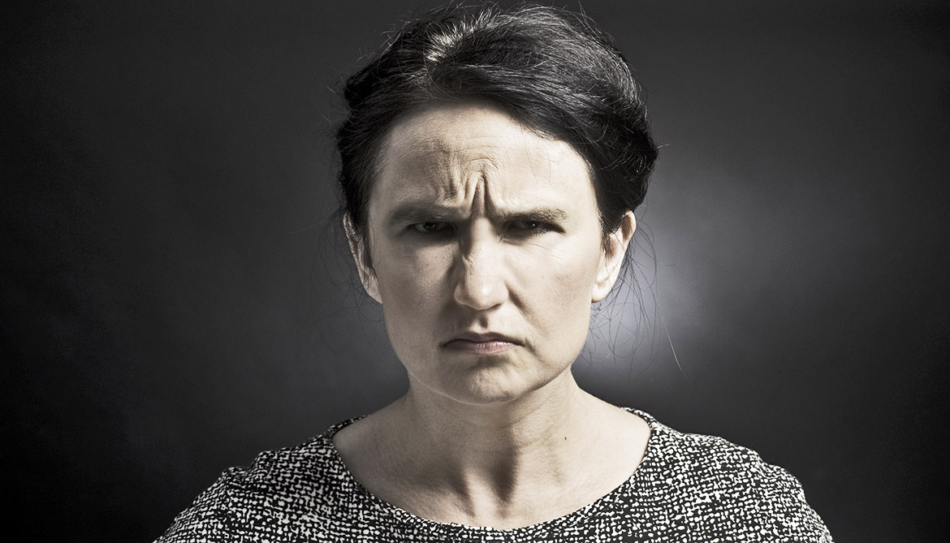
What emotion do you see?

Slide 19
What emotion do you see?

Slide 20
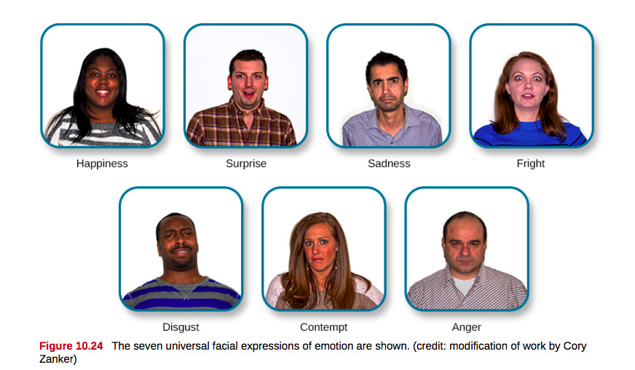
Notes:
Use this slide to touch on the 7 basic emotions that have been identified in human facial features.

Slide 21
What emotion do you see?

Slide 22
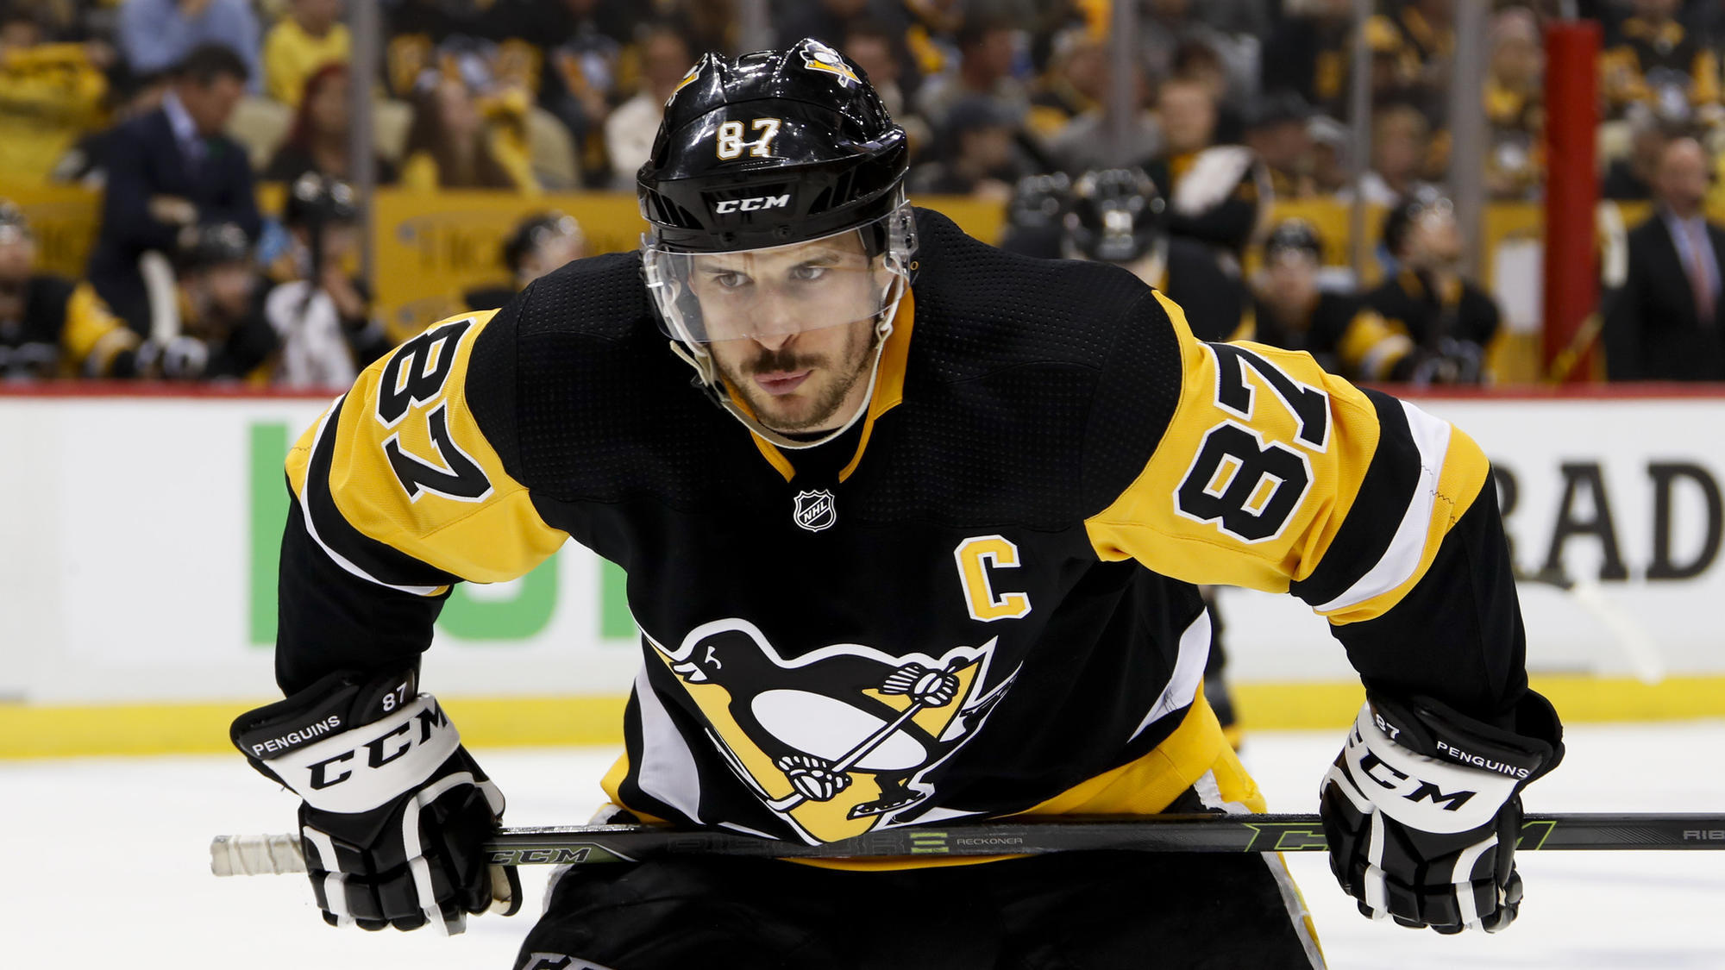
What emotion do you see?
Notes:
Point out that he is the best hockey player in the league

Slide 23
What emotion do you see?

Slide 24
What emotion do you see?

Slide 25
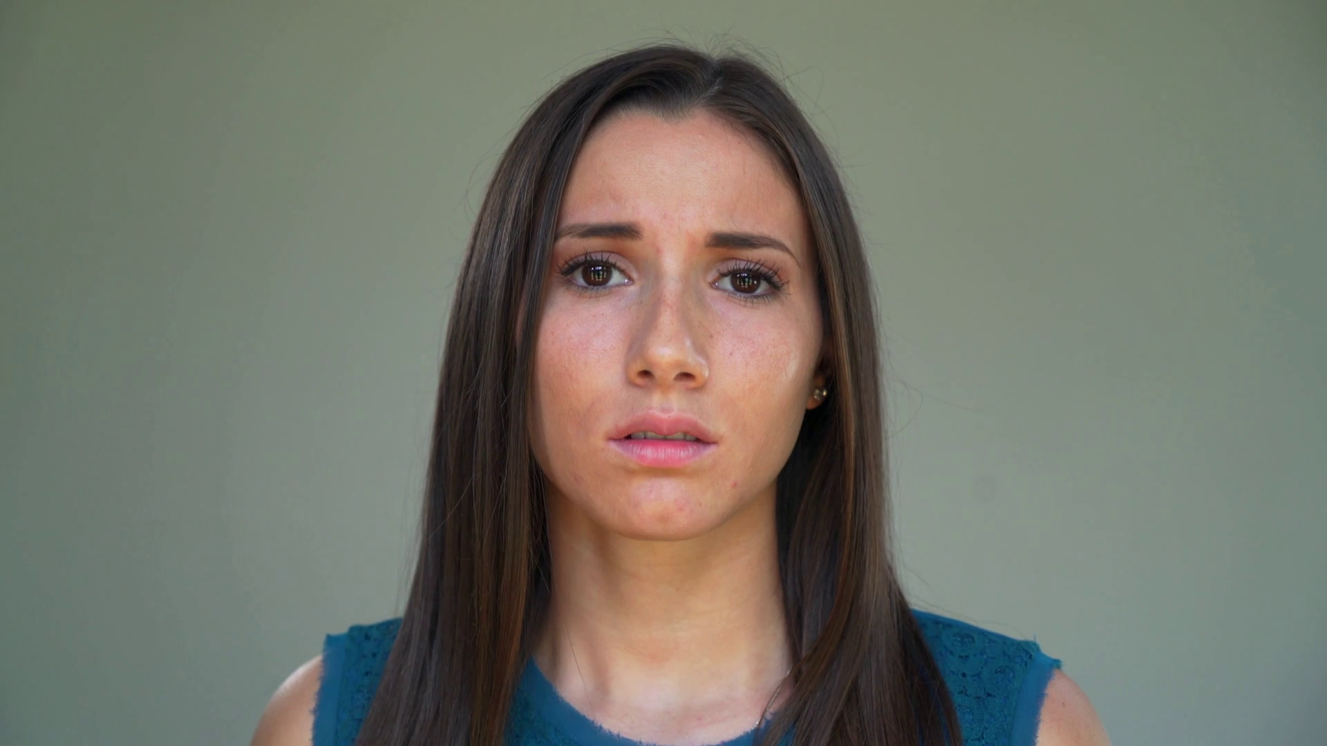
What emotion do you see?

Slide 26
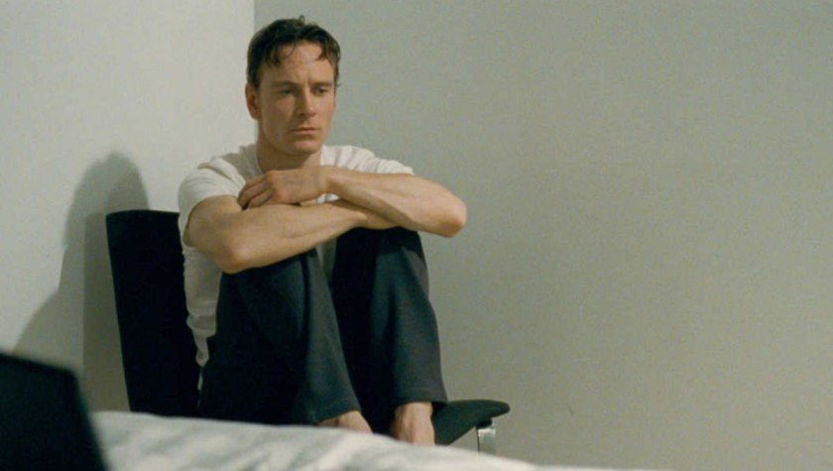
What emotion do you see?

Slide 27
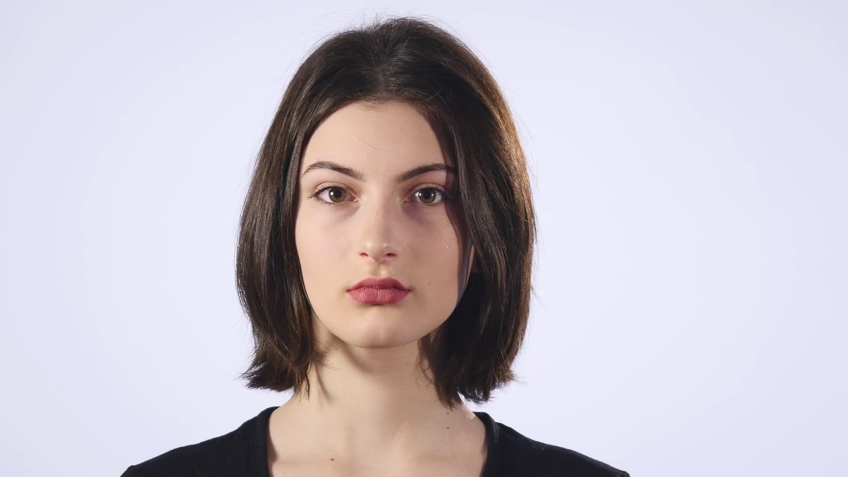
What emotion do you see?
The next picture is your last and hardest try your best!

Slide 28
What emotion do you see?

Slide 29
Barriers to Effective Communication
Arguing
Patronizing
Interrupting
Moralizing
Stuck in Rescuing
Using Jargon
What are other barriers?

Slide 30
In Summary
Build Rapport
Influence
Find a resolution

Slide 31
THANKS!
Any questions?
You can find us at
jbludworth@cabq.gov
nrosenbaum@cabq.gov

