Slide 1
Sleep Disorders
Nancy L. Martin, MD
University of New Mexico
Department of Psychiatry and Behavioral Sciences

Slide 2
Overview
Discuss classification of sleep disorders
Review normal sleep structure
Define specific sleep disorders

Slide 3
Classification of sleep disorders:
Insomnias
Hypersomnias
Parasomnias
Circadian rhythm disorders
Sleep-related breathing disorders
Sleep-related movement disorders
Notes:
by primary complaint. There are 85 sleep disorders, with eight major categories. Will talk about 6 of them as the 7th is the trashbin category of “other sleep disorders” and the 8th is a category of isolated symptoms, unresolved issues, or normal variants.

Slide 4
Classification of sleep disorders:
Insomnias: difficulty with sleep initiation, maintenance, and final awakenings leading to dissatisfaction with sleep quantity
Hypersomnias: daytime sleepiness
Parasomnias: undesirable physical or experiential events that accompany sleep
Circadian rhythm disorders: recurrent/persistent misalignment between actual/desired sleep pattern
Sleep-related breathing disorders: disordered respirations during sleep
Sleep-related movement disorders: simple, stereotyped movements that disturb sleep

Slide 5
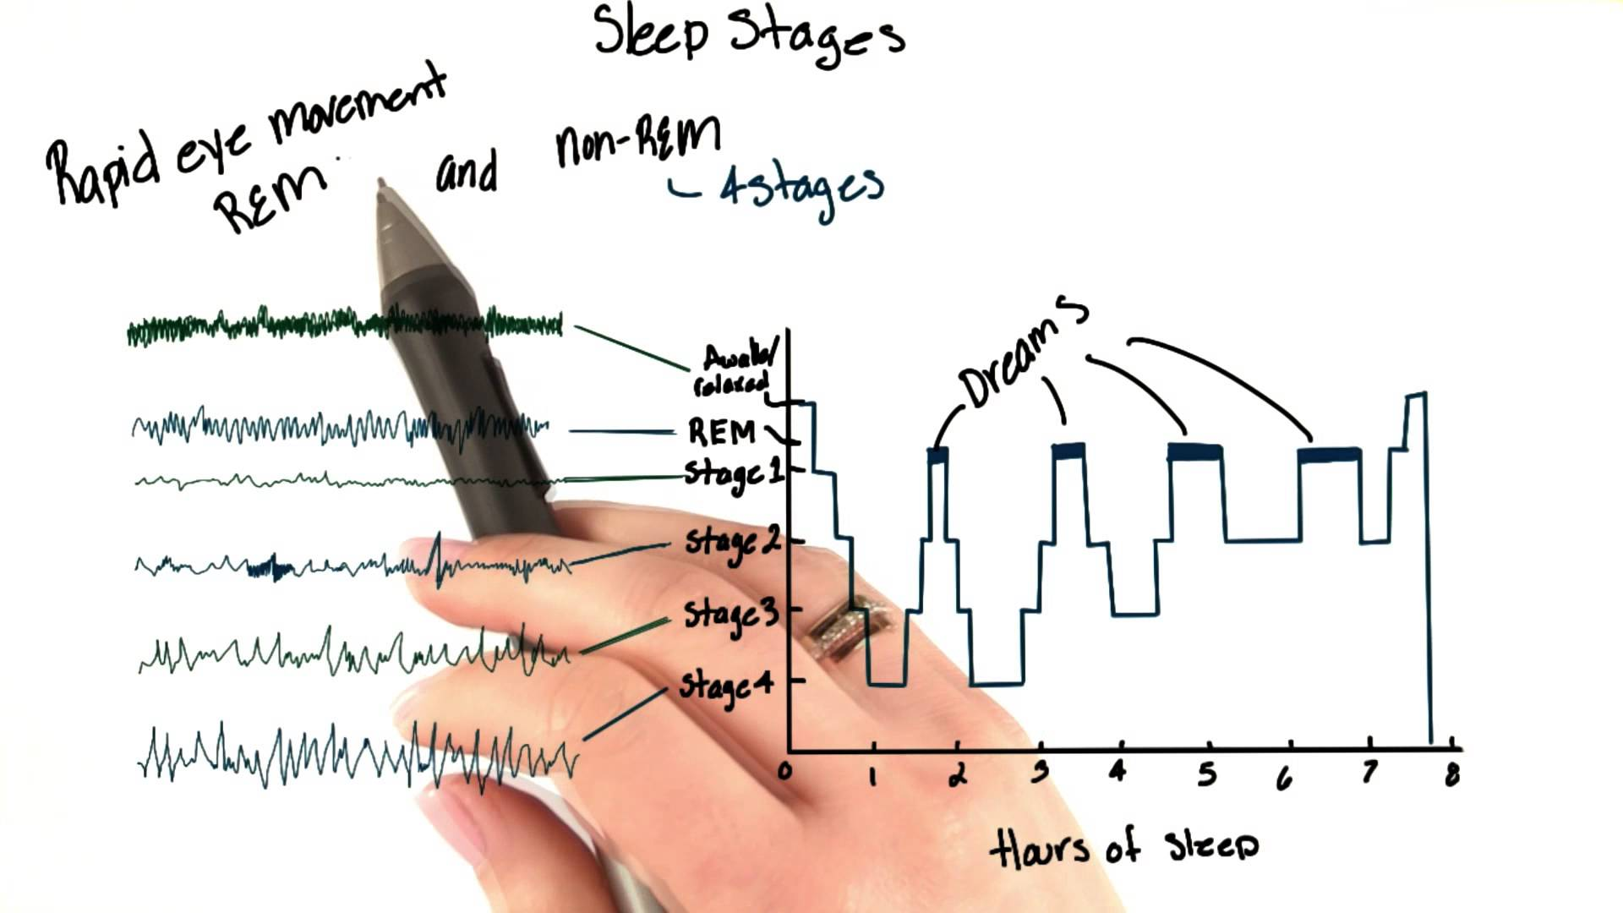
Nature volume 497, (23 May 2013)

Slide 6
Sleep latency
Time to fall asleep
Alpha waves
Stage 1
Light sleep
Hallucinations/sleep talking may occur
Stage 2
Sleep spindles, K-complexes
Brain waves slow down
Stage 3/4
Delta slow waves
Stage 5
Characterized by rapid eye movements
Body is motionless
Vivid dreaming; active brain waves similar to when thinking
Body repairing itself
Sleeping walking and night terrors can occur
Body temperature and heart rate decreases
Sense of falling may be common

Slide 7
Insomnias
Symptom of difficulty with sleep initiation, maintenance, and final awakenings leading to dissatisfaction with sleep quantity.
Symptoms occur despite adequate time and opportunity for sleep.
Results in some form of daytime impairment.
Includes complaints characterized by the perception of poor quality or “nonrestorative” sleep, even when amount/quality is adequate.
Can be either rrimary or secondary in nature.

Slide 8
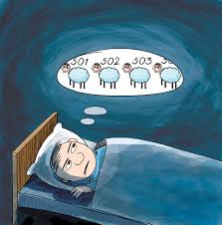

Slide 9
Primary Insomnia
Intrinsic and extrinsic factors involved in etiology
Multiple types
Psychophysiologic insomnia
Paradoxical insomnia
Adjustment sleep disorder
Inadequate sleep hygiene
Notes:
1. Psychophysiologic insomnia: most common, present for 1 month, characterized by heightened level of arousal with learned sleep-preventing associations. What CBT-I aims at treating.
2. Paradoxical insomnia: complaint of severe insomnia occurring without evidence of objective sleep disturbance and without daytime impairment to the extent that would be suggested by the amount of sleep disturbance reported.
3. Adjustment sleep disorder: insomnia associated with specific stressor, which can be psychological, physiologic, environmental, or physical.
4. Inadequate sleep hygiene is a disorder associated with common daily activities that are inconsistent with good quality sleep and full daytime alertness, like irregular sleep onset/wake times, stimulating activities before bed, substances ingested (alcohol, caffeine, nicotine)

Slide 10
Secondary Insomnia
Occur when insomnia is a symptom of a medical or psychiatric illness, or substance use.

Slide 11
How much sleep is needed?
Sufficient amount of sleep required to feel alert, refreshed, and avoid falling asleep unintendedly during waking hours.

Slide 12
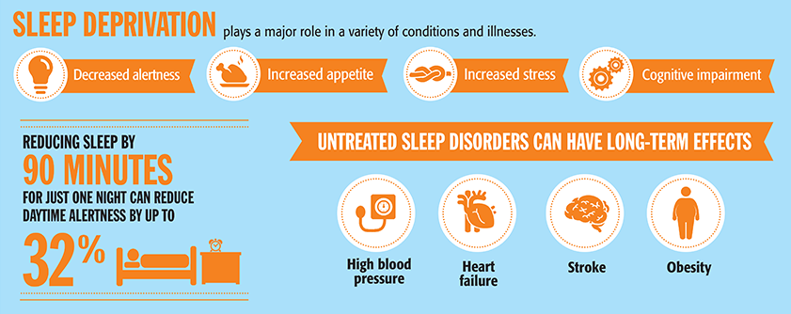

Slide 13
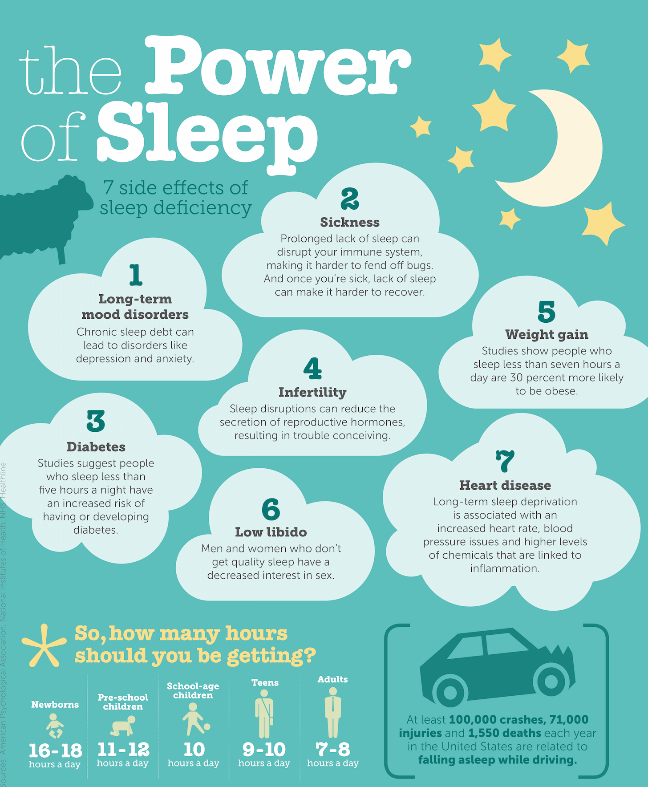

Slide 14
Hypersomnias
Primary complaint is daytime sleepiness not caused by disturbance in nocturnal sleep or misaligned circadian rhythms.
Daytime sleepiness is the inability to stay alert and awake during major waking episodes of the day resulting in unintended lapses into sleep.
Narcolepsy with/without cataplexy
Menstrual-related hypersomnia
Hypersomnias related medical condition/drug use

Slide 15
Narcolepsy with/without cataplexy
Excessive daytime somnolence occurring daily for at least 3 months
Nocturnal polysomnogram (min 6 hours) and multiple sleep latency test confirms diagnosis
Mean sleep latency < 8 minutes and 2+ naps demonstrates sleep-onset REM sleep
Notes:
Narcolepsy is a sleep disorder characterized by excessive sleepiness, sleep paralysis, hallucinations, and in some cases episodes of cataplexy (partial or total loss of muscle control, can lead to slack jaw, weakness of arms/legs/trunk, and is often triggered by a strong emotion such as laughter). Narcolepsy occurs equally in men and women and is thought to affect roughly 1 in 2,000 people. People with narcolepsy feel very sleepy during the day and may involuntarily fall asleep during normal activities. Narcolepsy with cataplexy is caused by the loss of a chemical in the brain called hypocretin, or orexin. Hypocretin acts on the alerting systems in the brain, keeping us awake and regulating sleep wake cycles. In narcolepsy, the cluster of cells that produce hypocretin is damaged or completely destroyed.

Slide 16
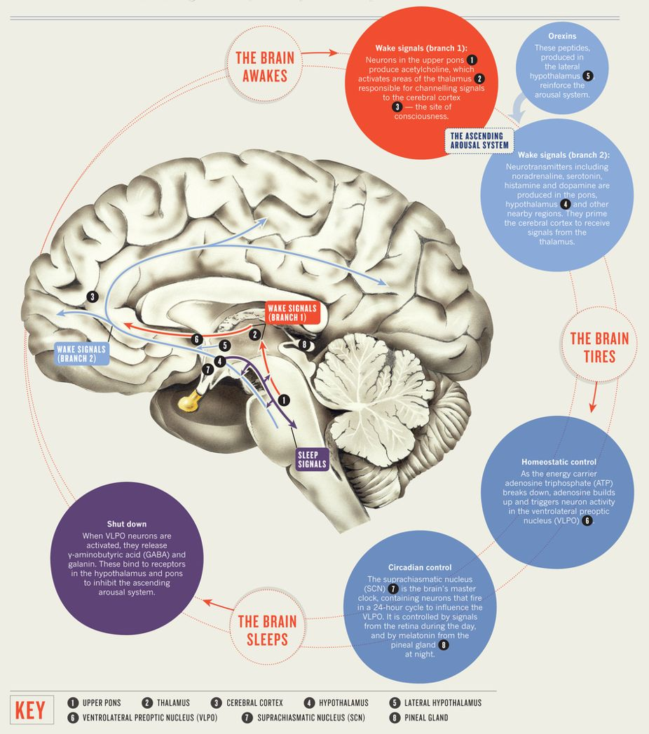
Nature volume 497, (23 May 2013)
Notes:
In the 1970s, the location of this internal clock of sorts was found to be the suprachiasmmatic nucleus, in rodents. The cluster of cells is part of the hypothalamus, brain center that regulates appetite and other biologic states. If this area is damaged, the sleep/wake rhythm disappeared and rats were no longer able to sleep on a normal schedule. Although largely self regulated, the clocks location allows it to respond to several types of external clues to keep set at 24 hours. Scientists call these clues “zeitgebers”, which means “time givers”
Light: most influential
Thoughts
Melatonin
The average american adult spends about 7.5 hours a day sleeping. Cats snooze about 15, horses 3, bats 20 hours.

Slide 17
Parasomnias
Characterized by undesirable physical or experiential events that accompany sleep.
Consist of abnormal sleep-related movements, behaviors, emotions, perceptions, dreaming, and autonomic nervous system functioning.
Considered disorders of arousal and sleep stage transition or manifestations of CNS activation and autonomic nervous system changes with skeletal muscle activity.
Classified according to occurrence during REM vs NREM sleep.

Slide 18
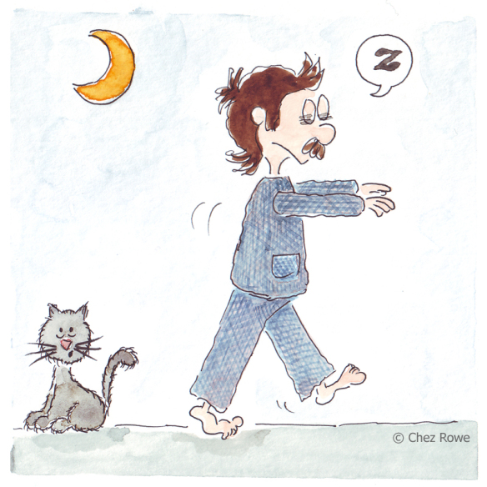

Slide 19
Parasomnias
NREM:
Sleep walking
Night terrors
Confusional arousals
REM:
REM sleep behavioral disorders
Nightmare disorder
Sleep enuresis
Exploding head syndrome
Notes:
NREM-related parasomnias include: Sleepwalking (also known as somnambulism and noctambulism). A condition affecting about four percent of adults, 15-20% of children. This disorder is not limited to walking; many other behaviors such as sleep-eating, sexsomnia (sleep-sex), sleep driving and even sleep-texting are becoming increasingly common. Children usually seem calm, to the point where a casual observer may think that the child is awake. Rarely, children may get up and urinate in places other than the toilet. One of the most common manifestations is your child wordlessly materializing at your bedside in the middle of the night, but not really seeming “all there.” Less commonly, children may be agitated, running around and yelling in a way analogous to a night terror. It’s important to remember that sleepwalkers can perform complex tasks such as unlocking doors and turning on the stove. Sleepwalkers can get injured if they get out of the house. This can be especially perilous if you are on vacation or, say, camping by a cliff. Night terrors: Fear, terror, disorientation, sweating, rapid heartbeat, screaming, and thrashing are just some of the frightening symptoms of night terrors. As with other parasomnias, children tend to experience night terrors more than adults. Confusional arousal. Confusional arousal often occurs when people arouse other people from sleep. The newly awakened people could be confused and disoriented and experience memory and speech problems. The timing is similar to the events above, and these events will usually present as some moaning, talking, and maybe a little light thrashing in bed. They typically last longer than night terrors but are milder– a 5–15 minute duration is common.
REM-related parasomnias: REM sleep behavior disorder (RBD). People with REM sleep disorder can experience vivid dreams and try to mimic the behavior occurring in their dreams, even though they may be experiencing temporary muscle paralysis, a condition known as atonia. Hallucinations. People might experience hypnagogic hallucinations while falling asleep or hypnopomic hallucinations while waking up from sleep. Sleep enuresis. This is a term for urinating while sleeping (bed-wetting), another parasomnia more common in children. Exploding head syndrome. People with this condition sometimes say it feels as if they have exploding bombs in or near their heads while they are trying to fall asleep. Exploding head syndrome is often related to insomnia, jet lag, emotional tension, and stress. It might be caused by the brain’s inability to shut down certain functions as people fall asleep.

Slide 20
Circadian-rhythm disorders
Share a common underlying chronophysiologic basis
Recurrent/persistent misalignment between actual/desired sleep pattern
Delayed or advanced sleep-phase
Irregular sleep-phase type
Shift work sleep type
Jet-lag type

Slide 21
Sleep-related breathing disorders
Characterized by disordered respirations during sleep.
Central apnea disorders: respiratory effort diminished or absent in an intermittent or cyclical fashion.
Primary central sleep apnea
Secondary central sleep apnea
Obstructive sleep apnea: characterized by obstruction in airway resulting in increased breathing effort and inadequate ventilation.
Notes:
Central vs obstructive: cessation of breathing without associated ventilatory effort.
Primary typically due to CNS dsyfunction
Secondary most often associated with long-term use (at least 2 months) of opioids, as the drug causes respiratory depression by acting on the mu-receptors of the ventral medulla in the brainstem.
Obstructive pattern involves repetitive episodes of cessation of breathing (apneas) or partial upper airway obstruction (hypopneas) that last at minimum of 10 seconds that are associated with reduced blood oxygen saturation, snoring, and sleep disruption.

Slide 22
Notes:
Central sleep apnea. Stage 2 sleep (indicated by the number 2 watermark) of a 52-yo male with central sleep apnea episodes. This is a 45 second page. Tracings from top to bottom are airflow, chest, abdomen, and O2 saturation leads. The first 8 second show normal airflow, chest, and abdomen signals, then there is a signal attenuation in the top three leads representing no airflow and no respiratory effort. Normal respiration resumes after the apneic event, and see an oxygen desaturation from 97% to 91%.

Slide 23
Notes:
Obstructive sleep apnea. Again, this is stage 2 sleep. This is a 43 yo male with obstructive sleep apnea and a 30 second page. Tracings from top to bottom are C4-A1 lead (central head), O1-A2 (occipital head), airflow, chest, abdomen, and O2 saturation leads. Note the normal airflow, chest, and abdomen signals for the first 10 seconds, followed by a cessation of airflow (box) with persistent chest and abdomen signals (indicating persistent respiratory effect) for the next 12 seconds, then a return to normal airflow, chest, and abdomen signals. Again see associated oxygen desaturation from 97% to 91%.

Slide 24
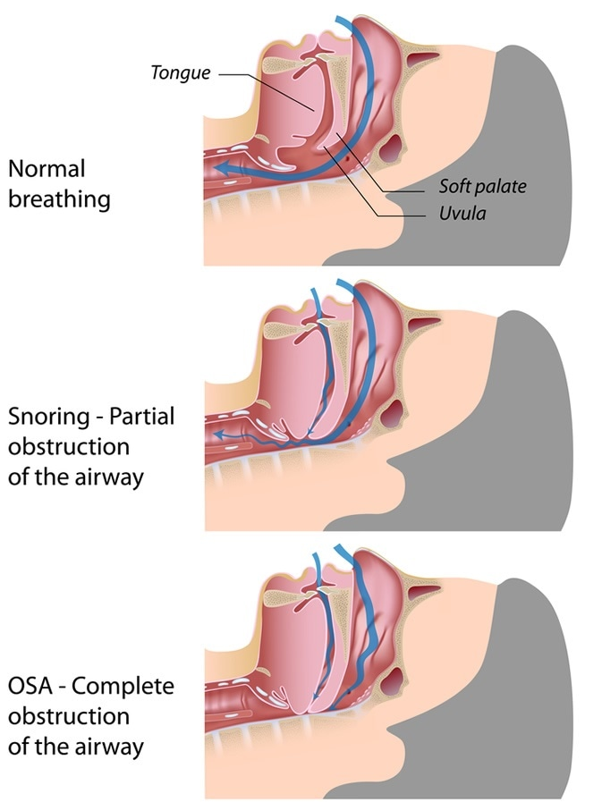

Slide 25
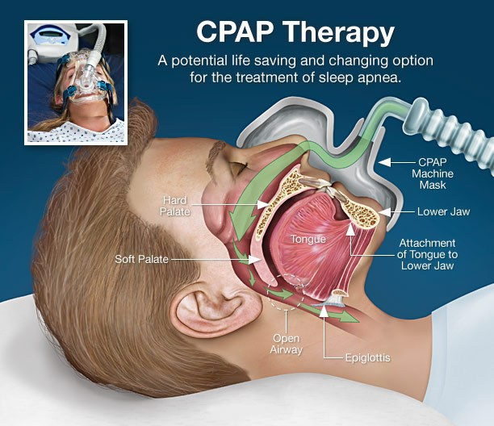
Notes:
Continuous positive airway pressure

Slide 26
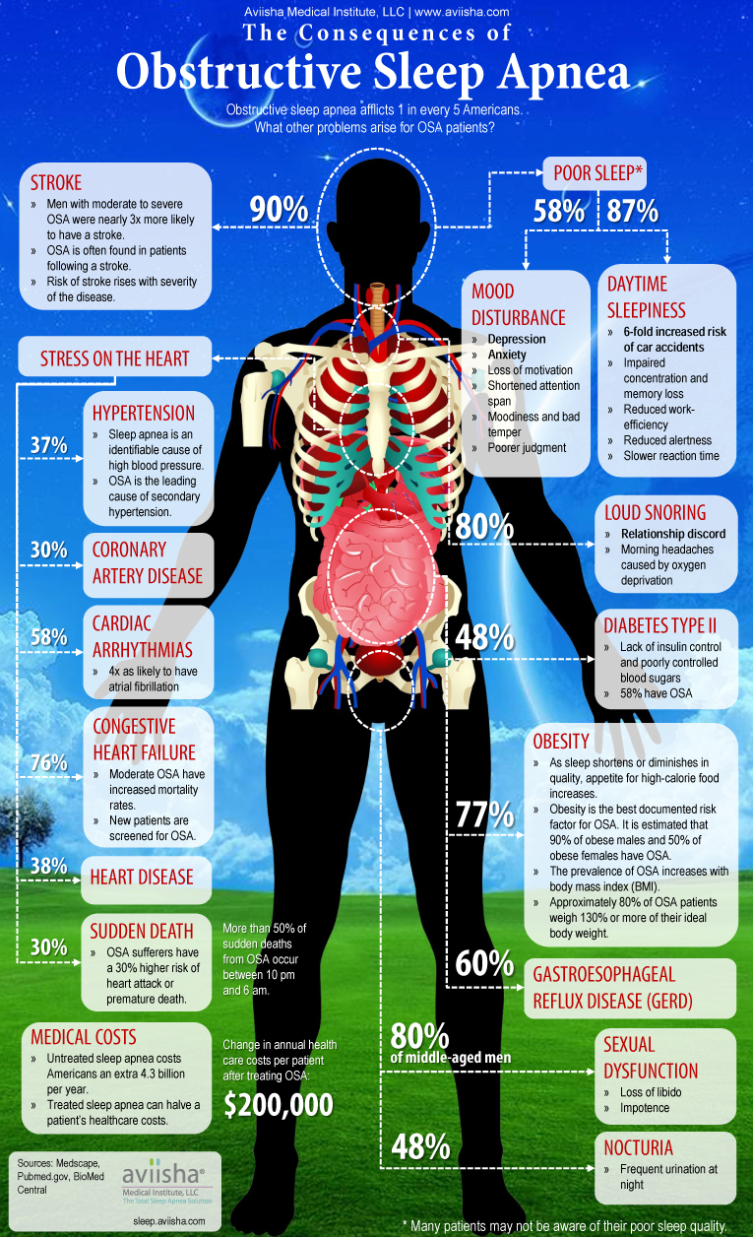

Slide 27
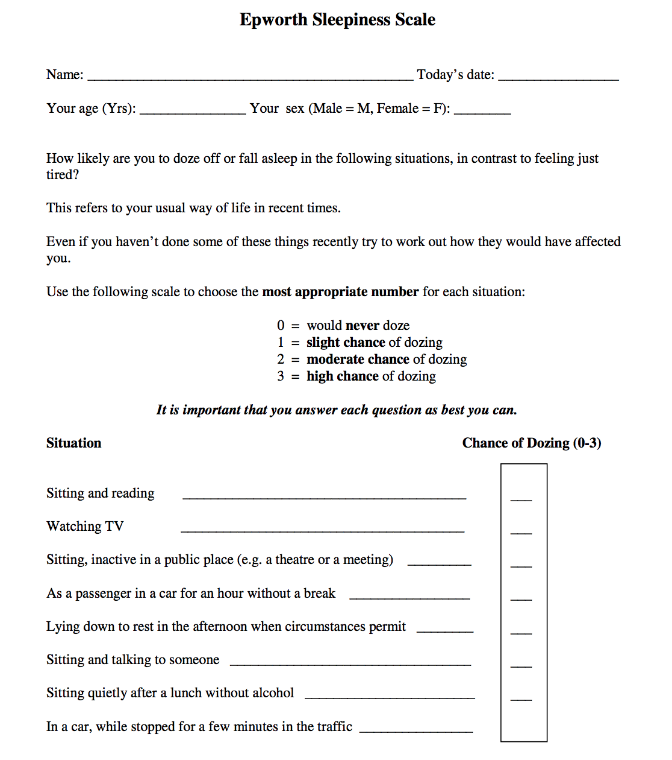

Slide 28
https://www.youtube.com/watch?v=UwjeVRdy5u4

Slide 29
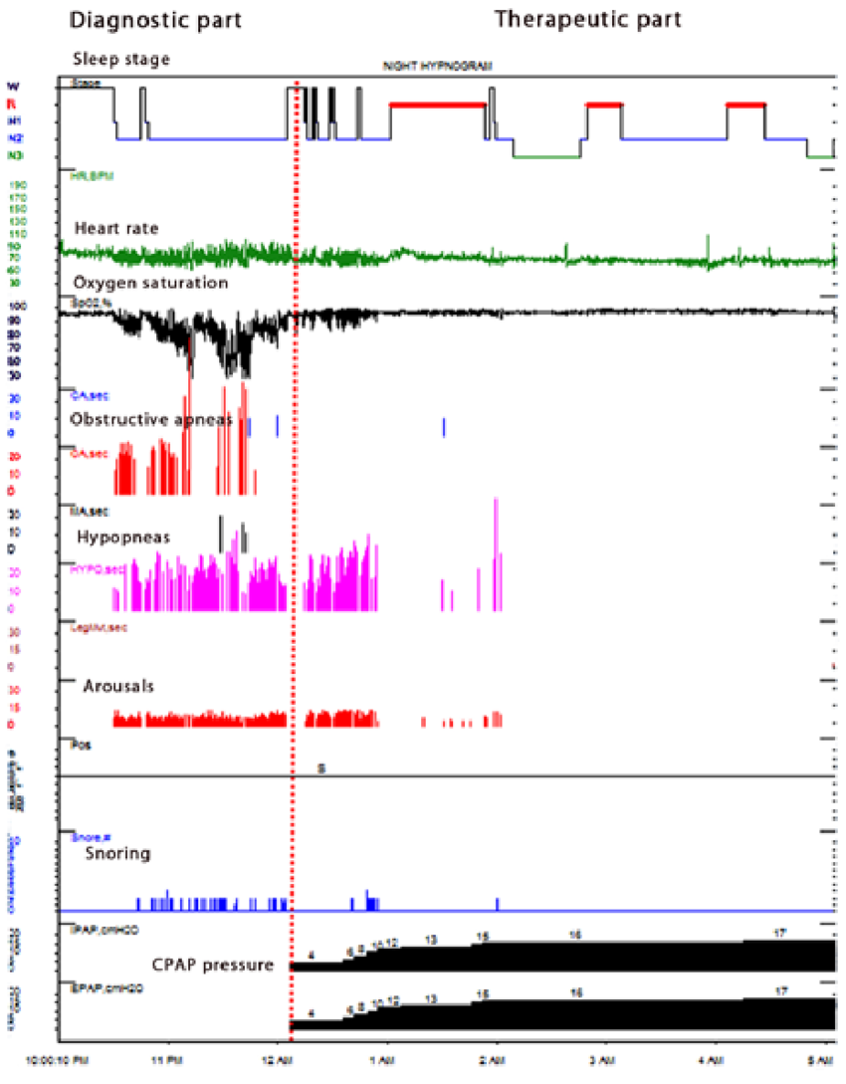
Notes:
A hypnogram of a patient with obstructive sleep apnea. A split-night sleep study was performed. The first part of the study is the diagnostic part. It shows high number of apneas and hypopneas associated with significant desaturation and arousals. The patient spent his sleep in stages N1 and N2 only. The second part of the study is the therapeutic part on CPAP. When the optimal CPAP pressure was reached, apneas and hypopneas were eliminated and oxygen saturation remained >90%. The patients' sleep progressed into stages N3 and REM sleep.

Slide 30
Sleep-related movement disorders
Simple, stereotyped movements that disturb sleep.
Restless leg syndrome: complaint of strong, nearly irresistible urge to move the legs occurring in evening/night with relief from walking or moving.
Periodic limb movement disorder: highly stereotyped limb movements associated with sleep disturbance occurring during sleep.
Sleep-related leg cramps.
Sleep-related bruxism.
Notes:
Myoclonus. This is the technical term for jerks, twitches, or seizures that can occur during this time.
Nocturnal leg cramps. Muscle contractions sometimes cause nighttime cramping and pain, especially in older adults.
Rhythmic movement disorder (RMD). Children who make repetitive movements and rock themselves to sleep might have RMD, a condition most children outgrow by the age of five. Children with this disorder might also bang or roll their heads while sleeping.
Bruxism. People with bruxism grind their teeth or clench their jaws. Excess stress might contribute to this condition.

Slide 31
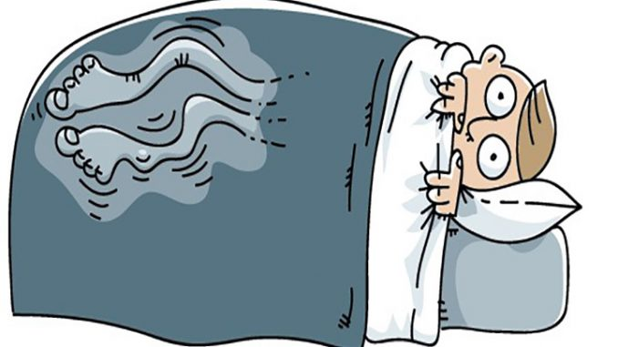

Slide 32
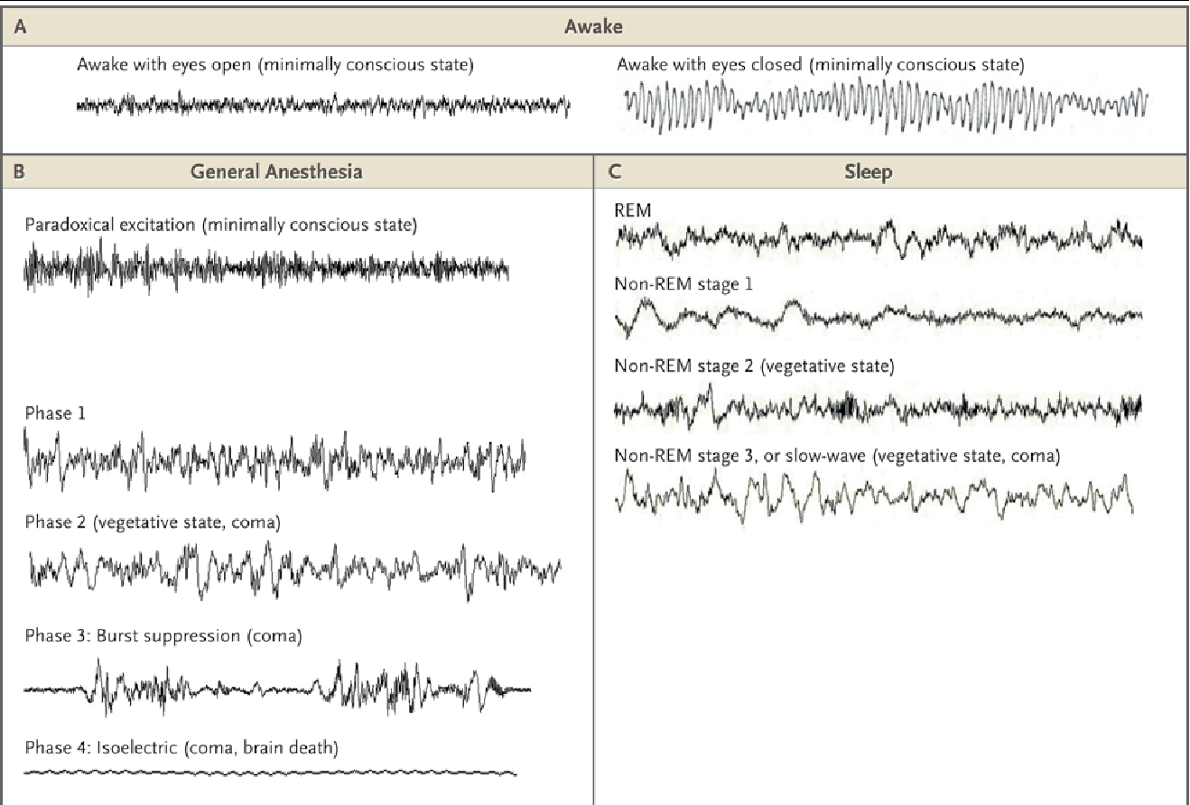

Slide 33
Questions?

