Slide 1
Dementia
Mohamad Khafaja, M.D.
Kanchan Kohli, M.D.
August 8, 2017
University of New Mexico

Slide 2
OBJECTIVES
Discuss clinical signs & symptoms of Dementia and differentiation from Depression and Delirium
List 3 types of behavioral disturbances in Dementia
Describe legal and ethical issues related to Dementia

Slide 3
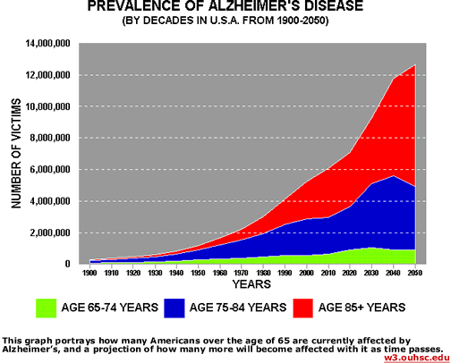

Slide 4
Normal Aging
Subjective memory complaints
Annoying but not disabling problems
Frequent problems with name retrieval
Minor difficulties in recalling detailed events

Slide 5
What Conditions Are Not Dementia?
Age-related cognitive decline: slower information processing and mild memory impairment
Depression: short term memory loss
Delirium : confusion and rapidly altering mental states

Slide 6
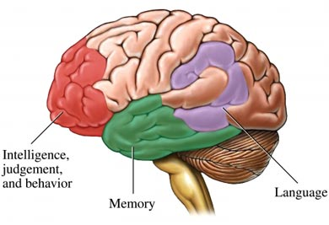
Brain Anatomy

Slide 7
Dementia Diagnosis
Memory
Language
Execution of purposeful movement
Recognition/familiarity
Visuospatial function
Self control/management

Slide 8
Dementia Diagnosis
Interview
Cognitive Testing
Physical Examination
Brain Imaging
Laboratory Testing

Slide 9
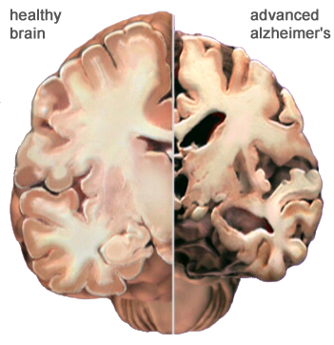

Slide 10
Living with Dementia
Getting lost in familiar places
Not recognizing familiar faces
Wandering
Confusion
Urinary incontinence
Pain
Feeding problems

Slide 11
Behavioral &Psychological Manifestations of Dementia
Depression
Anxiety
Abnormal motor behavior
Irritability
Apathy
Agitation
Disinhibition and impulsivity
Delusions and Hallucinations
Change in appetite

Slide 12
Dementia: Care
24-hour care and supervision
Assistance with daily activities such as eating, bathing, and dressing
Sharp knives, dangerous chemicals and tools should be removed
Bed and bathroom safety rails
Removing locks from bedroom and bathroom doors
Lowering the hot water temperature to 120° F or less

Slide 13
Dementia: Risk Reduction
Regular Exercise
Mediterranean Diet: Fish, nuts, vegetables, fruit and grains
Intellectually stimulating exercises
Lower Cholesterol and Blood pressure
Vitamin E &B supplementation

Slide 14
Dementia: Caregivers
Difficult job
Maximize independence and provide assistance
Early Dementia: Patients may cooperate
Later Stages: Exposed to belligerent and violent behaviors
Sundowning: Afternoon agitation
1 in 3 will develop symptoms of depression
Signs: irritability, anger, mood swings, fatigue and poor sleep

Slide 15
CASE
A neighbor calls 911 for a wellness check on an 81-year-old woman living alone
House smells of urine
Cats feces on the floor
Woman appears to be physically well
Alert and oriented to person and place
You suggest a transport to ER
She refuses

Slide 16
Ethical & Legal Issues
ETHICAL PRINCIPLES:
1. Autonomy (FREEDOM)
2. Beneficence (DO GOOD)
3. Non-maleficence (DO NO HARM)
4. Justice

Slide 17
Determining Decisional Capacity
Communicate a choice
Understand the nature and consequences of their choice
Rationally manipulate the information necessary to make the choice
Reason consistently with previously expressed values and goals

Slide 18
Law Enforcement & Dementia
Erratic driving
Auto accidents
False reports
Indecent exposure
Shoplifting
Suicide & Homicide

Slide 19
Law Enforcement & Dementia: Driving
Dementia increases risk of crashing
Difficult to convince not to drive
Many do not understand that the illness is progressive
Road evaluation remains the gold standard for assessing the safety
Few states have laws mandating physicians to report drivers with Dementia

Slide 20
Law Enforcement & Dementia: Tips for Interacting
Identify yourself as a law enforcement officer
Explain why you’ve approached the person
Maintain good eye contact
Speak slowly in a non-threatening, low-pitched voice
Use short, simple words
Notes:
Loudness can convey anger; do not assume the person is hearing-impaired.

Slide 21
Law Enforcement & Dementia: Tips for Interacting
Ask “yes” and “no” questions
Ask one question at a time, allowing plenty of time for a response
Maintain a calm environment, devoid of chaos and excessive stimuli
Reduce radio volume and avoid use of sirens
Avoid restraints
Avoid confrontation

