Slide 1
Crisis Intervention Teams (CIT)
Becoming a Reality in East Mississippi…
It Can Be Done!
2014 MH/IDD Joint Conference
Biloxi, Mississippi
East Mississippi Crisis Intervention Team

Slide 2
East Mississippi CIT Panel
Amy Bishop, LMFT, SAP
Spencer Blalock, MSW, LCSW
Chief Deputy Ward Calhoun
Elon Espey, NP
Debbie Ferguson, Dr.PH
Captain Wade Johnson, retired
Diane Mills,

Slide 3
Purpose
Identify strategies & partnerships for implementing local CIT
Identify differences between multiple points of service & single point of entry
Identify opportunities & barriers to CIT implementation
Notes:
Objective 1: Participants will be able to identify strategies and partnerships for implementing a local CIT
Content: This portion will cover the foreseen/unforeseen barriers, the solutions that have been found, the coordination and collaboration needed, and the joining of forces to create solutions. This will also cover the multiple/ongoing trainings that take place to create competent workforce.
Objective 2: Participants will be able to identify differences between multiple points of service and single point of entry
Content: This portion will cover how multiple interrelated teams work together from various settings to triage various levels of crisis, de-escalate the crisis, and coordinate the appropriate level of care (Mobile Crisis, ER, CIT Officer, CSU).
Objective 3: Participants will be able to identify evidence-based solutions for barriers to CIT implementation, as well as future options for further development
Content: This portion will cover the limitations encountered (limited space, difficult to treat patients), as well as potential for future services (intermediate levels of care) such as Living Room Model, Certified Holding Facilities, Respite Services, and Tele-Court. The Lauderdale CIT Training HUB will also be discussed.

Slide 4
Purpose
Identify strategies & partnerships for implementing CIT

Slide 5
MS Department of Mental Health
Strategic Plan
GOAL 1
To increase access to community-based care and supports through a network of service providers that are committed to a resiliency and recovery-oriented system of care
GOAL 2
To utilize information/data management to enhance decision making and service delivery
GOAL 3
To maximize efficient and effective use of human, fiscal, and material resources

Slide 6
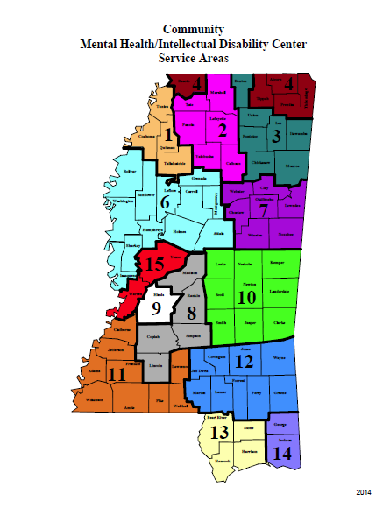
Notes:
9 counties in the “catchment” area.
Population of Region 10 is 242,517
If one in four experience mental illness in a given year- 60,630 people*

Slide 7
Weems Mental Health Center
Outpatient therapy
Alcohol/Drug Therapy
Residential Treatment
Employee Assistance Program

Slide 8
Central Mississippi Residential Center
Residential Care
Crisis Stabilization Unit
Footprints Adult Day Services

Slide 9
Law Enforcement
Lauderdale County Sheriff’s Department
50 Sworn deputies
Lauderdale County Detention Facility

Slide 10
Law Enforcement
Meridian Police Department
120 Sworn Officers
Utilizes the Lauderdale County Detention Facility

Slide 11
Mental Health (Before CIT)
Acute & Crisis Psychiatric Services
Waiting Lists
Commitments
Crisis Stabilization Units (CSU)
Minimal collaborative work

Slide 12
Mental Health (Before CIT)
Economy
- Post Katrina
- Recession
Department of Justice

Slide 13
Law Enforcement (Before CIT)
Only contact with mental health system by law enforcement was through court-committals.
There weren’t any legal or procedural recourses in place in providing care for consumers.
Officers had minimal options when resolving complaints involving consumers.

Slide 14
Advocates (Before CIT)
Mental Health still had contact with advocates
Call resolution/Contact with Law Enforcement

Slide 15
Consumers (Before CIT)
Mental Health providers relationships remained the same
Mostly negative contact with Law Enforcement led to negative results

Slide 16
2009 - 2011
Community Action Group
Access to care
- Access to crisis services
- Diversion from jails
-CIT (Memphis Model)
Justice and Mental Health Collaboration Grant
PATIENCE

Slide 17
Significant Challenges
Funding
Organization
Single Point of Entry
Cultures
Organizational Priorities
Leadership
Turfs and Toes

Slide 18
Breaking Down Barriers
Community Partnership on Mental Health
Mental Health
Law Enforcement
NAMI
Consumers
Medical
Metro Ambulance
Help agencies

Slide 19
CIT Task Force
Comprised of Mental Health and Law Enforcement
Establishes guidelines for CIT Program
Schedules and conducts CIT training
Multi-disciplinary review of CIT calls, statistics,
and reports
Checks and balances
Memorandum of Understanding (Good Fences)

Slide 20
Implementation
Mississippi CIT Law already in place
Trained first CIT officers
Train the Trainers

Slide 21
Single Point of Entry
Why does success depend on this and why is it
so hard to achieve?

Slide 22
Medical Screening

Slide 23
Law Enforcement Results
Lauderdale County Sheriff’s Department
- 29 CIT Officers (including SROs)
Meridian Police Department
- 27 CIT Officers

Slide 24
Law Enforcement Results
Meridian Public School Districts
- 5 CIT Officers
Other Surrounding Agencies
- 7 CIT Officers

Slide 25
Law Enforcement Results
Officer Buy-in
- Understanding Mental Health Systems
- Understanding Advocacy
- Understanding Consumers

Slide 26
Mental Health Results
April 2013-September 2014
Admissions
- Total
- Monthly
Length of Stay
Readmission

Slide 27
Our Partnership
Weems Mental Health Center
Central Mississippi Residential Center
- Adult Single Point of Entry
Alliance Hospital
- Ages 12-17 Single Point of Entry
Lauderdale County Sheriff’s Department
Meridian Police Department
Meridian NAMI & NAMI Mississippi

Slide 28
Summary
The agencies and organizations involved in the East Mississippi Crisis Intervention Team maintain a professional relationship in an attempt to provide the best resolution for those in mental health crises.

